Slide 1
Final Project
Catherine Chung

Slide 2
Idea One
Suicide rate in Korea
Focusing on education
Using data from OECD.org

Slide 3
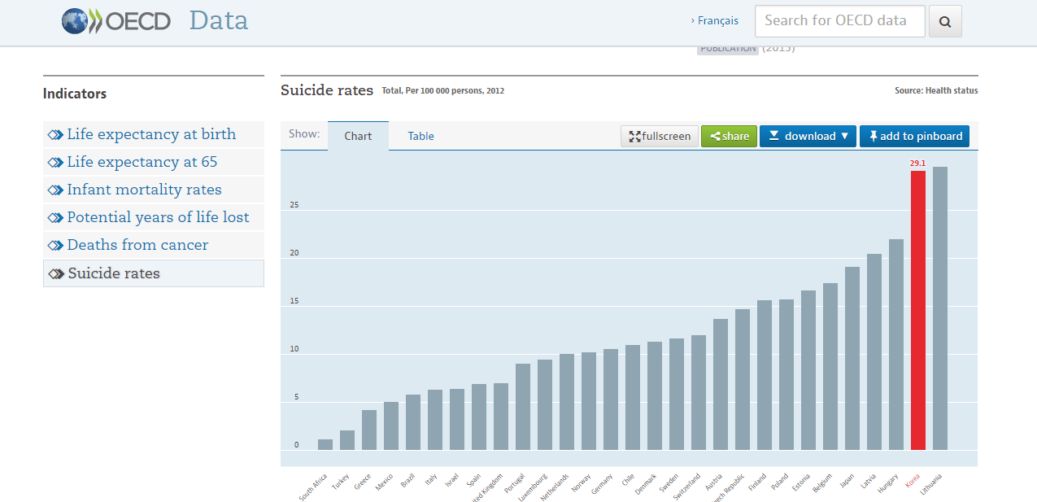

Slide 4
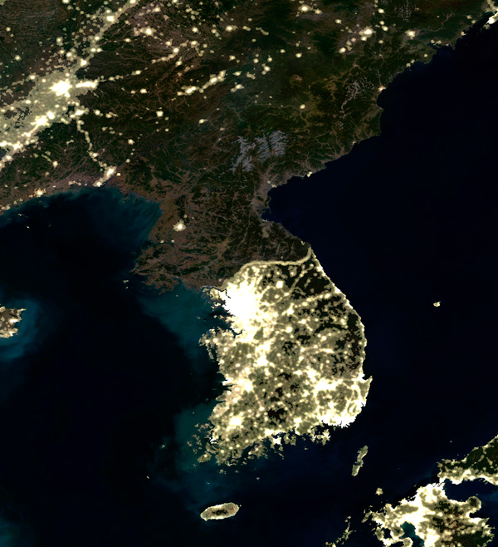

Slide 5


Slide 6
WebGL
Point Light for the light bulbs
Each light bulb is a “life”
Combination of Images and drawing
Education themed

Slide 7
Idea Two
Painting Flowers

Slide 8
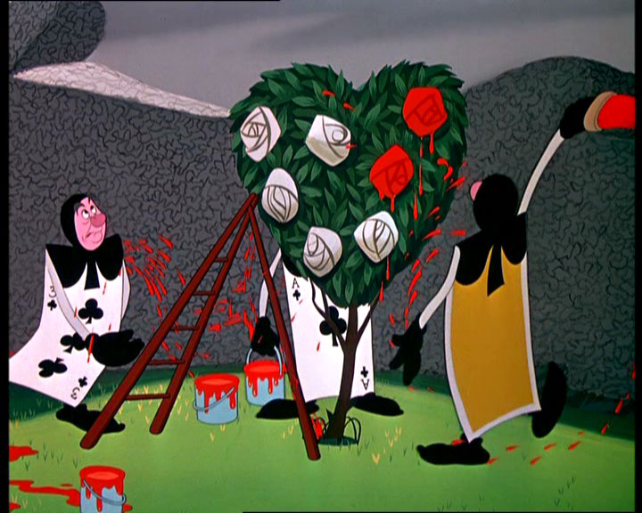
Inspiration: Alice in Wonderland

Slide 9
Particles as the “paint”
Rotating Flower
WebGL
Changing shapes to look like flowers

Slide 10
Idea Three
Simple game
get ball from point A to point B using as little lines as possible

Slide 11
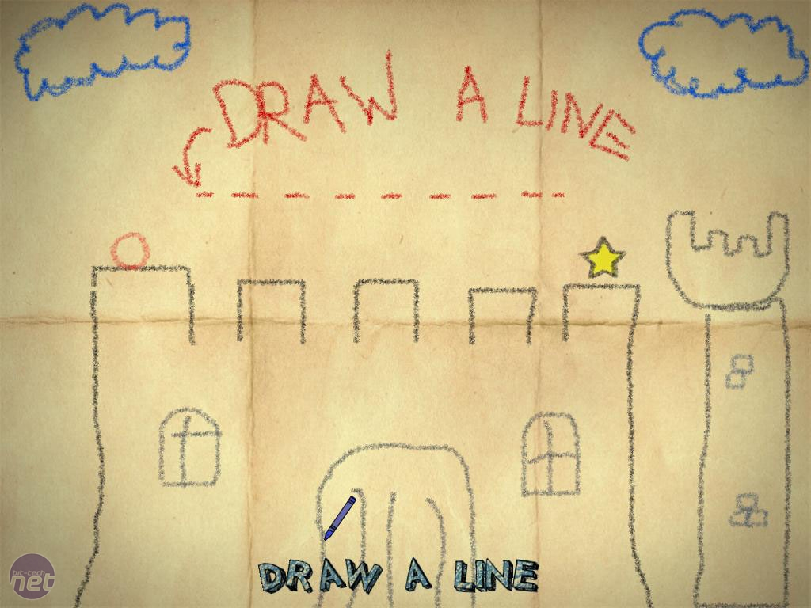
Inspiration: Crayon Physics

Slide 12
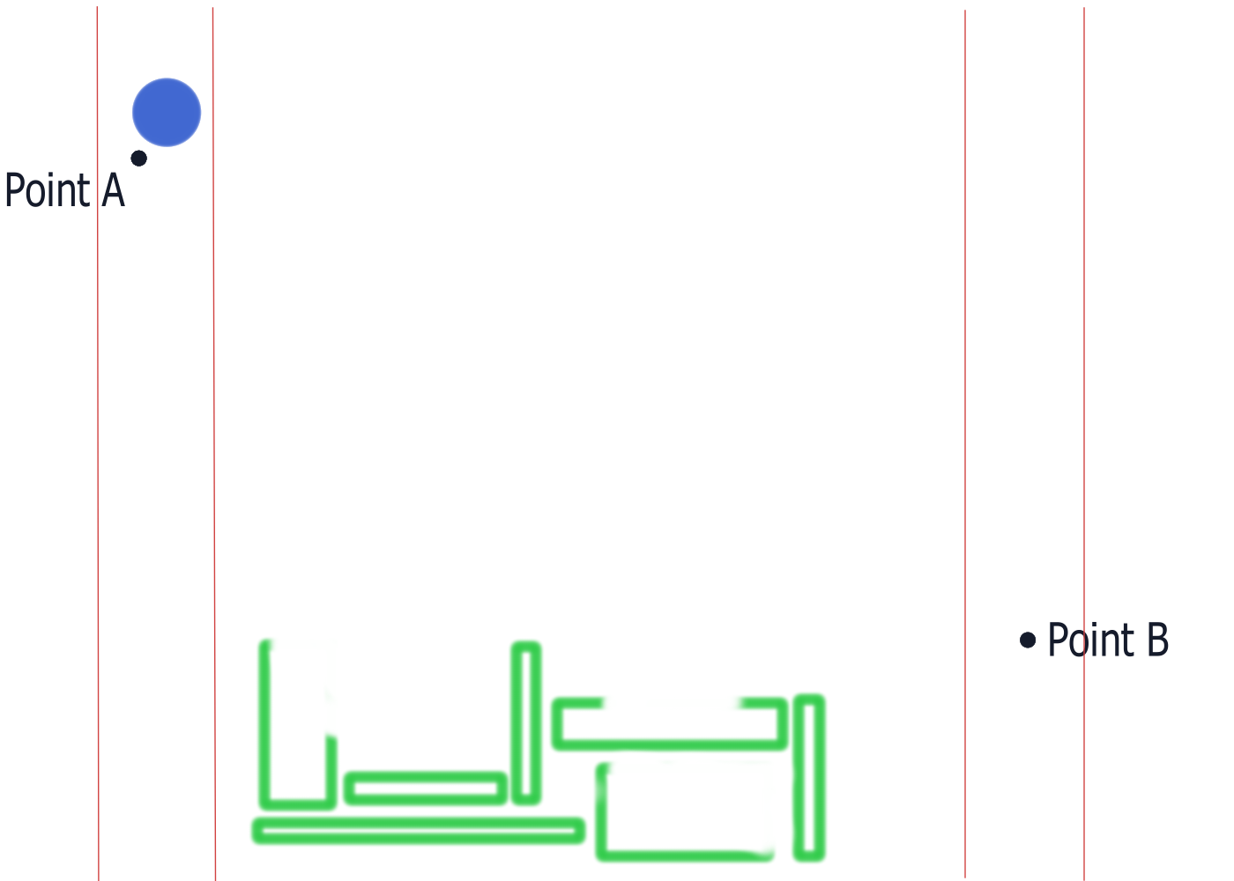

Slide 13
Processing
Physics
Chapter 5 in Nature of Code
Online Resources

